Slide 1
Cloud Computing
Part II

Slide 2

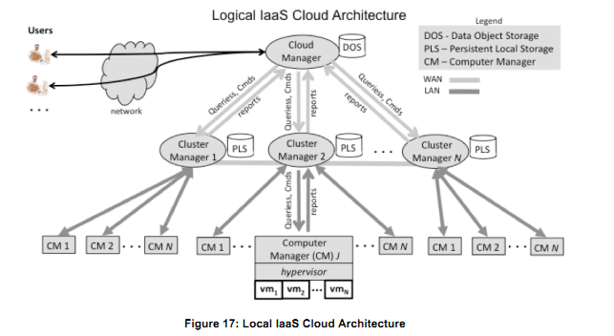
Logical View

Slide 3
Cloud Manager
The Cloud Manager is the public access point to the cloud where subscribers sign up for accounts, manage the resources they rent from the cloud, and access data stored in the cloud.
The Cloud Manager includes mechanisms for authenticating subscribers, and for generating or validating access credentials (e.g., cryptographic keys) that subscribers then employ when communicating with their virtual machines.

Slide 4
Cloud Manager
The Cloud Manager also performs top-level resource allocation; when a subscriber issues a command to rent a number of resources, the Cloud Manager must determine if the cloud has enough free resources to satisfy the request, and if so, which Cluster Manager (or Managers) have some or all the resources.
If the request can be satisfied, the Cloud Manager must commit to the allocation of the resources at the participating Cluster Managers, and must coordinate the setup of virtual networking so that the subscriber can uniformly access all resources.
The Cloud Manager will also enforce any cloud-global policies governing resource requests.

Slide 5
Cloud Manager
In addition to coordination with Cluster Managers, Cloud Manager connected to the cloud’s Data Object Storage (DOS) repository.
In actual implementations, the DOS could be distributed or put on different networks; however, the DOS services need to be available both to running virtual machines in the cloud and to systems from outside the cloud, and must be coordinated sufficiently with the Cloud Manager to keep track of valid subscriber identities both to allow their administrative actions in the DOS and for billing.
These constraints imply a structure with close ties between the DOS and the Cloud Manager, and with wide-area network access from the DOS to both running virtual machines and external systems.

Slide 6
Cluster Manager
Each Cluster Manager is responsible for the operation of a collection of computers that are connected via high speed local area networks.
A computer cluster may contain hundreds or thousands of computers.
A Cluster Manager receives resource allocation commands and queries from the Cloud Manager, and calculates whether part or all of a command can be satisfied using the resources of the computers in the cluster.
A Cluster Manager queries the Computer Managers for the computers in the cluster to determine resource availability, and returns messages to the Cloud Manager on whether part, or all, of a request can be satisfied in a cluster.

Slide 7
Cluster Manager
If subsequently directed by the Cloud Manager, a Cluster Manager then instructs the Computer Managers to perform resource allocation, and reconfigures the virtual network infrastructure to give the subscriber uniform access.
In addition to being connected to individual computers via LAN links each Cluster Manager also connected to Persistent Local Storage (PLS).
As discussed above, virtual machines need persistent disk-like storage to preserve their work while virtual machines are de-allocated and later reallocated.
The most natural location for this storage is where very high speed connections to virtual machines are available, but where the storage is not permanently bound to any specific computer system.

Slide 8
Computer Manager
At the lowest layer in the hierarchy, the Computer Manager cooperates with the hypervisor that runs on each computer system in a cluster.
In response to queries from its Cluster Manger, a Computer Manager returns status information including how many virtual machines are running and how many can still be started.
In response to commands issued from its Cluster Manager, a Computer Manager uses the command interface of its hypervisor to start, stop, suspend, and reconfigure virtual machines, and to set the local virtual network configuration.
With some hypervisor technologies, network packets exchanged between different virtual machines running on the same hypervisor can be implemented in very high performance in-memory messages, thus boosting performance.

Slide 9
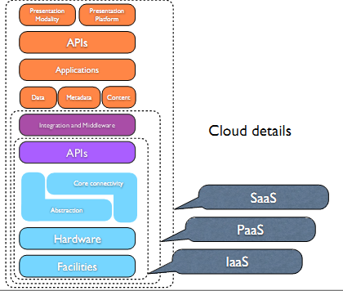
Cloud Reference Model

Slide 10
        Q & A

Slide 11
        THANK YOU

